Slide 1
Genomic Variant Interpretation for Diagnosis and Discovery
Nicole Weaver, MD
Society for Craniofacial Genetics and Developmental Biology
Annual Meeting
October 19, 2021

Slide 2
Clinical and Molecular diagnosis
Dysmorphology
Structural anomalies
Medical history
Family history
Clinical Genetics New Visit
Diagnosed
Chromosomes
Microarray
Gene panel
Methylation
Repeat expansion
Exome/Genome
Down syndrome (trisomy 21)
22q11 deletion (Velocardiofacial)
Treacher Collins, Noonan syndrome
Russel Silver syndrome, Prader Willi syndrome
Spinocerebellar ataxia, Fragile X syndrome
Various
Diagnostic testing
None
Undiagnosed
Notes:
This baby looks like it doesn’t have any body. Proclaimed dysmorphic by my 5 yo daughter.
What is a genetic diagnosis?
“Clinical diagnosis” meaning based on recognizable pattern of features
e.g., Down syndrome, Treacher Collins syndrome. If a specific pattern is recognized, test ordered, result identified, we have clinical diagnosis and molecular diagnosis
But, we know that there are different genetic changes that can lead to these syndromes
DS can be from full trisomy 21, or can be from a translocation
TCS can be caused by TCOF1 as well as POLR1C, POLR1D, and POLR1B pathogenic variantsThere is an increasing number of clinical tests. Clinical test means it is ordered by a physician, sent to a laboratory, billed to insurance, and a report is provided to the team documenting the results. I’ve listed old and new tests that are available, with examples of the conditions they diagnosis.
Exome and genome are the newest members of this list and are both available clinically and available in “rapid” form with quick turn around time in ill children.
What does “diagnosed” mean? We have found a genetic abnormality that explains most of a patient’s phenotype
Sometimes, there are TWO diagnoses
Parents often want to know WHY this happened to their child, what it means for the future, and if it might happen again in future pregnancies
Despite the availability of broad testing, there are still patients who remain without a diagnosis.

Slide 3
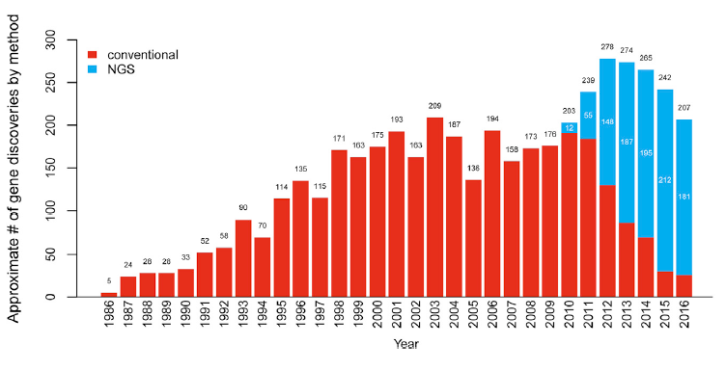
Why undiagnosed?
Uncertain result
Known gene, novel phenotype
Known gene, novel type of variant
Gene has been reported but only in a very small number of patients
No candidate causal variants/genes identified
Maybe the right test has not been done yet
Novel gene: Clinical lab cannot report variants in a gene if it does not know to look for it
Boycott et al 2017, AJHG
Notes:
We will assume that the undiagnosed child has access to recommended clinical testing. If this is case, why can we not find a diagnosis with all of this amazing testing available?
If the gene has not been identified yet, the clinical lab cannot report it
e.g.: . POLR1B was just recently identified—patient diagnosed clinically with TCS prior to this would have been undiagnosed from a molecular standpoint
Sometimes a variant might be found and it is in a gene not previously associated with the phenotype of your patient, but perhaps a different phenotype
Sometimes a test like an exome or genome is just negative—no reportable variants associated with the phenotype.
In this scenarios, could be a novel gene, or perhaps the pathogenic mechanism isn’t detected by genome (for example)

Slide 4
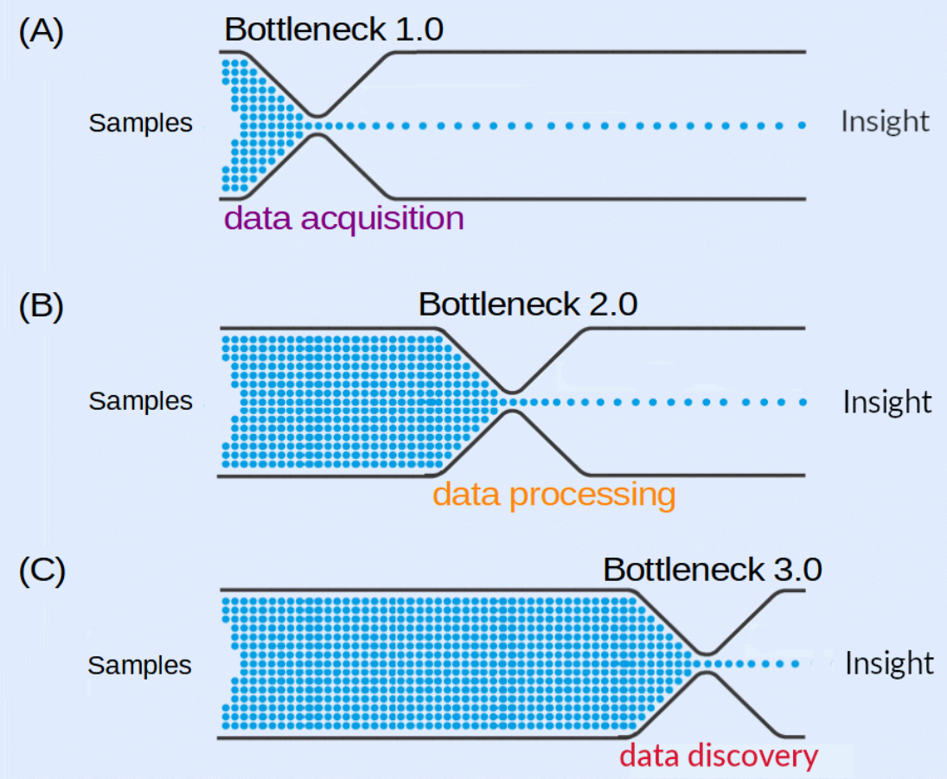
Diagnostic odyssey
Undiagnosed
Diagnosed!
Clinical data reanalysis
Research test
Research analysis
Candidate gene
Candidate variant
Confirmed gene-phenotype association
Sanger→ Next gen sequencing
Improved computing power, algorithms
https://bigomics.ch/2021/05/18/the-current-bottleneck-in-omics-data-analysis/
Notes:
Diagnostic odyssey is the length of time and the tests and medical visits a child and family goes on to move from undiagnosed to diagnosed
Bottleneck has shifted—first it was data acquisition (e.g., sequencing—Sanger is one gene at a time, now we can do genomes!)
Then, it was how to take all of the sequencing data and process it, align it. Solved with improved computing power.
But now, we have a bottle neck in the discovery area—how to analyze all of this data and interpret it in a meaningful way
Another bottleneck not pictured here is the process of validating a candidate variant—finding more patients, generating a model organism or in vitro model, and even before that, finding someone who has the expertise, funding, and inclination to generate a model. Given this new bottle neck it is more important than ever to have clinician-researcher communication and partnerships.

Slide 5
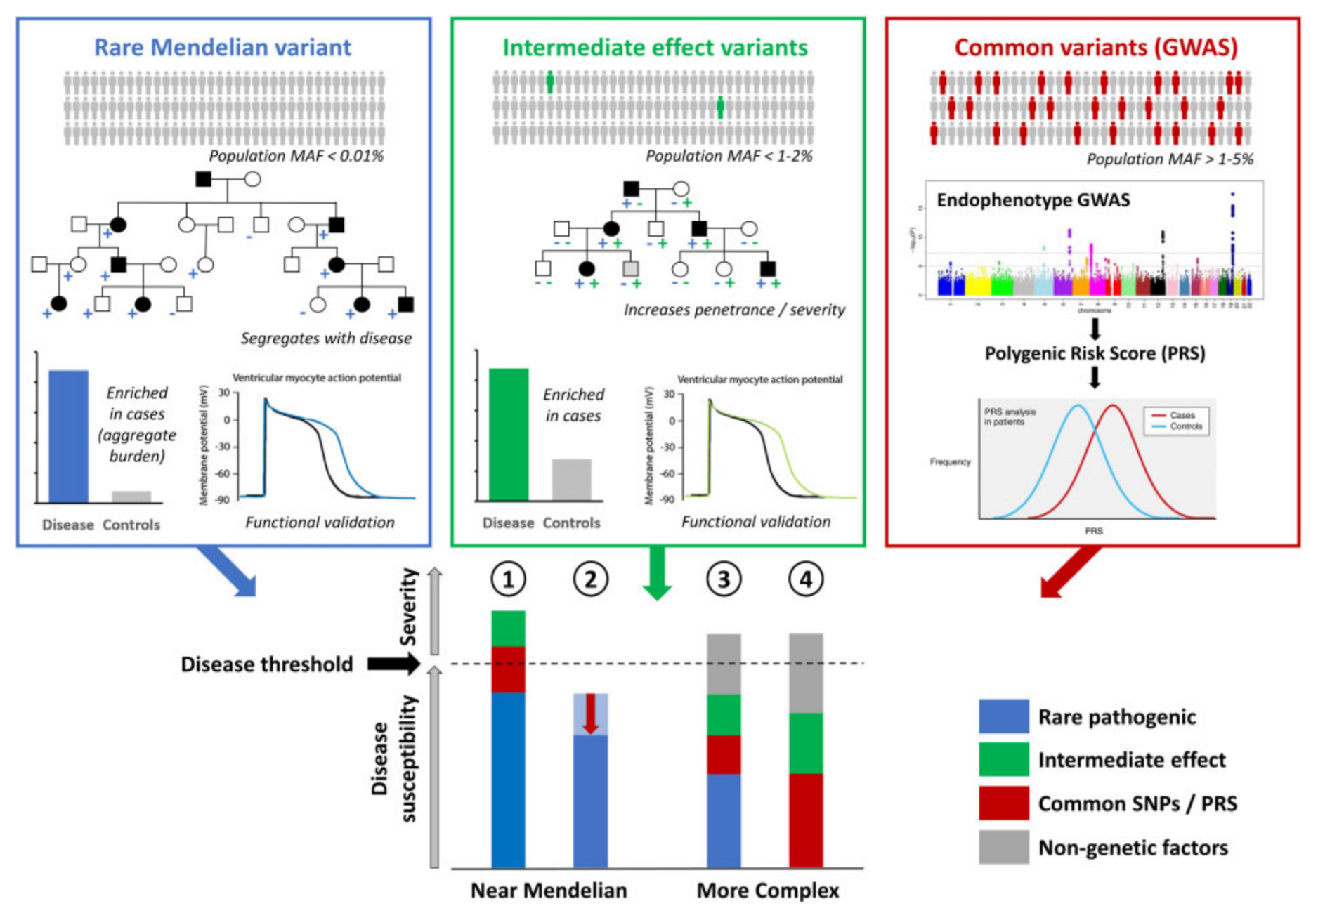
What are we looking for?
Unilateral cleft lip
Isolated congenital heart defect
When genetic burden reaches threshold. Walsh, Tadros, Bezzina 2020
Notes:
When considering a patient with multiple anomalies, what type of causal variant are we expecting? What type of variant are we looking for on the diagnostic odyssey?
Generally, we are looking for RARE and PATHOGENIC variants that cause the majority of the patient’s presentation (aka, Mendelian)
Multifactorial phenotypes in singles are not high yield for gene discovery because there are probably multiple variants contributing, plus environment (e.g., unilateral CL) (as mentioned yesterday—talk about non-syndromic cl
A variant that is common—meaning it is found in the general population—is unlikely to be causing a severe congenital anomaly
Common variants can CERTAINLY contribute to disease, as you can see here in this threshold model for Mendelian and complex traits. But, an individual common variant would be anticipated to have a smaller effect, therefore lower yield for in vivo or in vitro modeling in a model organism.
In contrast—we anticipate rare pathogenic variants will be highly penetrant

Slide 6
Gene discovery
Does sufficient evidence of pathogenicity exist to spend resources on development a model organism or studying in vitro?
How to find patients with variants in genes of interest to you
Is there a patient for my mouse (or other model organism)?
Notes:
AS I mentioned, variant/gene validation remains a bottleneck in gene discovery
So, you might find yourself approached by a clinician with a patient who has a variant in a candidate gene
Goals of the next 30 min or so are to walk through tools and considerations to help you decide if a candidate variant/gene is worth your resources
Patient gene→ researcher
Researcher gene→ patient
Major bottleneck in gene-discovery process is validation of variants as causal—e.g., the work done by scientists to develop model organisms or in vitro model
So, it is really important
When Sam asked me to talk about this topic, it was after she and I had several conversations about a patient with a variant in a gene that Sam studies. The patient’s variant was identified via clinical exome sequencing, and their phenotype was suggestive of a ciliopathy. But, the gene is not associated with human disease. Sam had been approached by the patient’s geneticist to see if she and her lab were interested in investigating the pathogenicity of this variant and our conversations surrounded how to interpret the variant and make this decision. So, the goal of today’s presentation is to review the current clinical genetics workflow for children with structural birth defects (or other issues suggestive of a Mendelian/monogenic diagnosis), and how basic scientists can intersect with clinicians and patients whose genetic diagnoses or undiagnosed phenotypes may be informative to your laboratory studies.
So the goal of this presentation is to provide information to you about how to assess whether a variant/gene presented to you by a clinician is a good “candidate” for patient’s phenotype, and potentially worth your resources to validate in vitro or in vivo
And the converse is also true—if you are studying a particular gene or pathway, how can you find patients who may have disease caused by variation in that gene

Slide 7
Terminology and Definitions
SNV: single nucleotide variant
Variant classifications:
Pathogenic, likely pathogenic variant
Variant of uncertain significance
Likely benign, benign variant
“Candidate gene”= gene has not yet been associated with a human phenotype but there is preliminary evidence that suggests it may be
Variant effects
Synonymous: coding change→same amino acid
Non-synonymous: coding change→different amino acid
Stop: AA codon→Stop codon
Frameshift: Multiple AA changes followed by premature Stop codon
Splice variant
Notes:
Mutation is out

Slide 8
Does this variant cause this phenotype?
Patient presents with:
Congenital contractures
Infantile spasms
Hypotonia
Poor feeding
Craniofacial differences
Trio exome (2015)
De novo POLR1A c.4685 G>T, p.C1562F
Notes:
This is an example of a gene with known association to human disease, but novel variant and found in a child with a novel phenotype
Prior association with just craniofacial and limb defects
This child has those, but also has infantile spasms and severe hypotonia
To illustrate the process of evaluating whether a variant is a good candidate I will use this example
Missense variant
While this is a gene with known association to human disease, in 2015 there only 3 published patients and none had seizures or hypotonia.
But their variants were located in different part of POLR1A

Slide 9
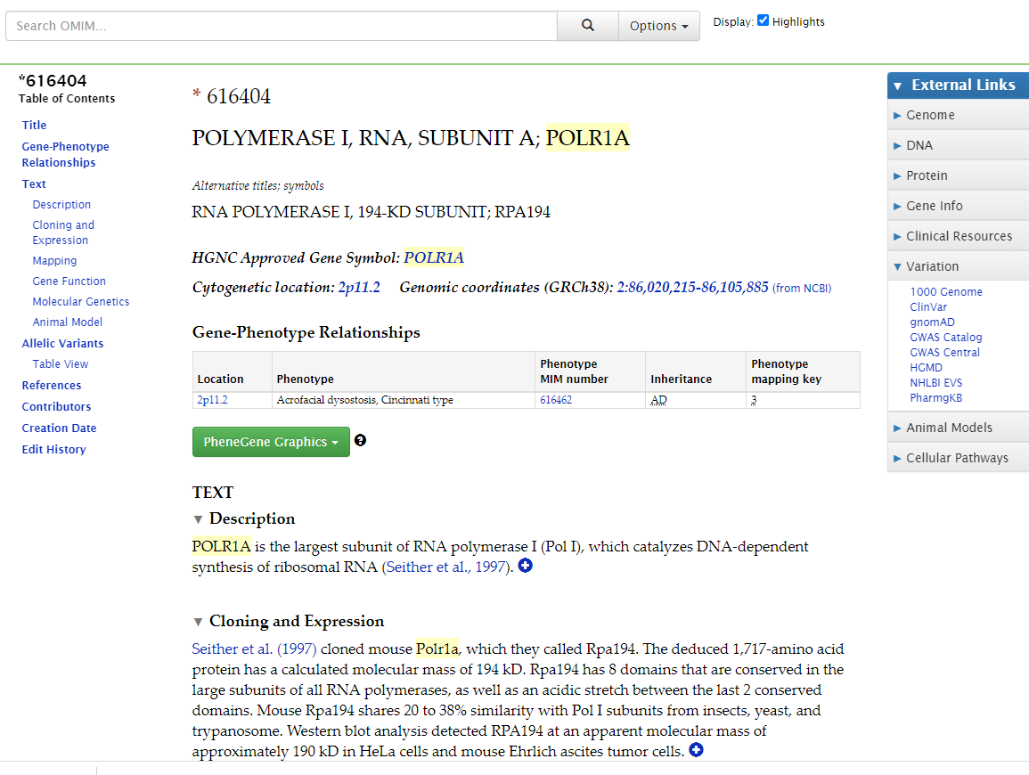
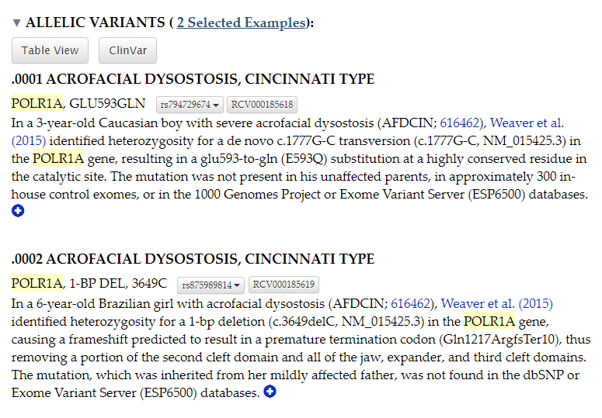
Basic gene considerations
Online Mendelian Inheritance in Man (omim.org)
Notes:
Animal model summary
“allelic variants”
Not perfect—if it is a really recently identified gene/disease association, might not be in omim yet

Slide 10
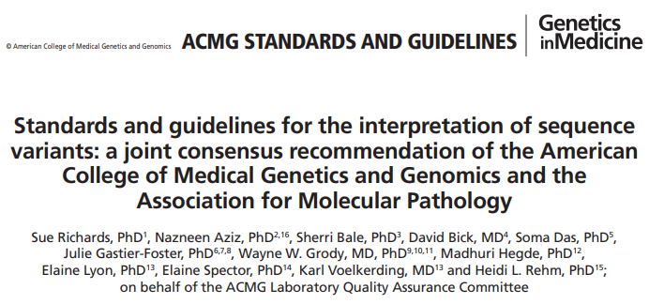
Other considerations
Population data
Computational and predictive data
Functional data
Segregation data
De novo data
Allelic data
Other database
Other data
Notes:
These are summarized in a paper from the American College of Medical Genetics (list ref). It is more for classifying variants in clinically known genes but same principles can be used for novel gene-disease
I am now going to go through each of these categories using an example

Slide 11
How do we use population data?
Notes:
By population data, I am referring to what variants are identified in normal/healthy population?
If we see a particular variant in healthy population, probably not causing a severe structural birth defect
GnomAD AKA genome aggregation database is a free browser that lets you enter a gene of interest and peruse the variants in that gene that were identified in normal/healthy population
The data set (v2.1) contains exome data from 125k and genome data from 15k individuals aggregated from multiple large-scale sequencing projects
Version 3 has 76k genomes, aligned to 38

Slide 12
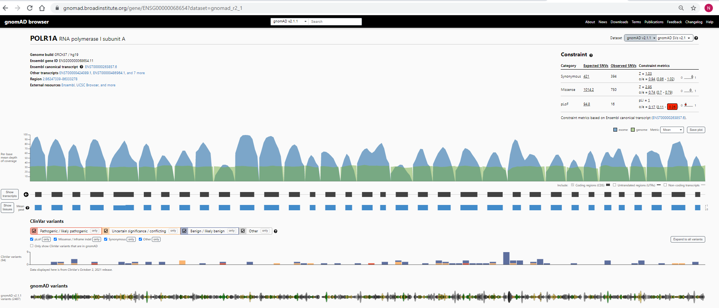
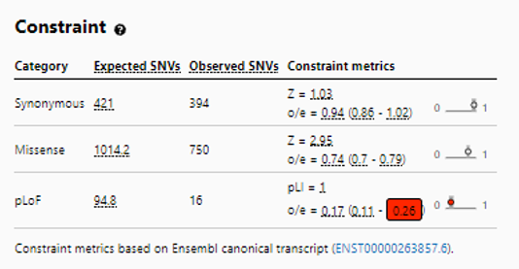
Conclusion: Intolerant to variation
Notes:
At the gene level, we can look at constraint—this tells a number of expected and observed variants in the gene
Expected is based on a model taking into account sequence context, coverage, and methylation
pLI= probability of being loss of function intolerant—closer to 1, more intolerant of protein truncating variants
Synonymous and nonsynonymous z scores—higher means more intolerant of variation
Observed/expected with 90% confidence interval, which is why there is a range here
Allows distinguishing cases where there is uncertainty about constraint for the gene due to sample size
(gene with a low expected SNV cannot have a high PLI)
Threshold recommended to use is the one in red—less than 0.35 is a suggested cut off for intolerant genes

Slide 13
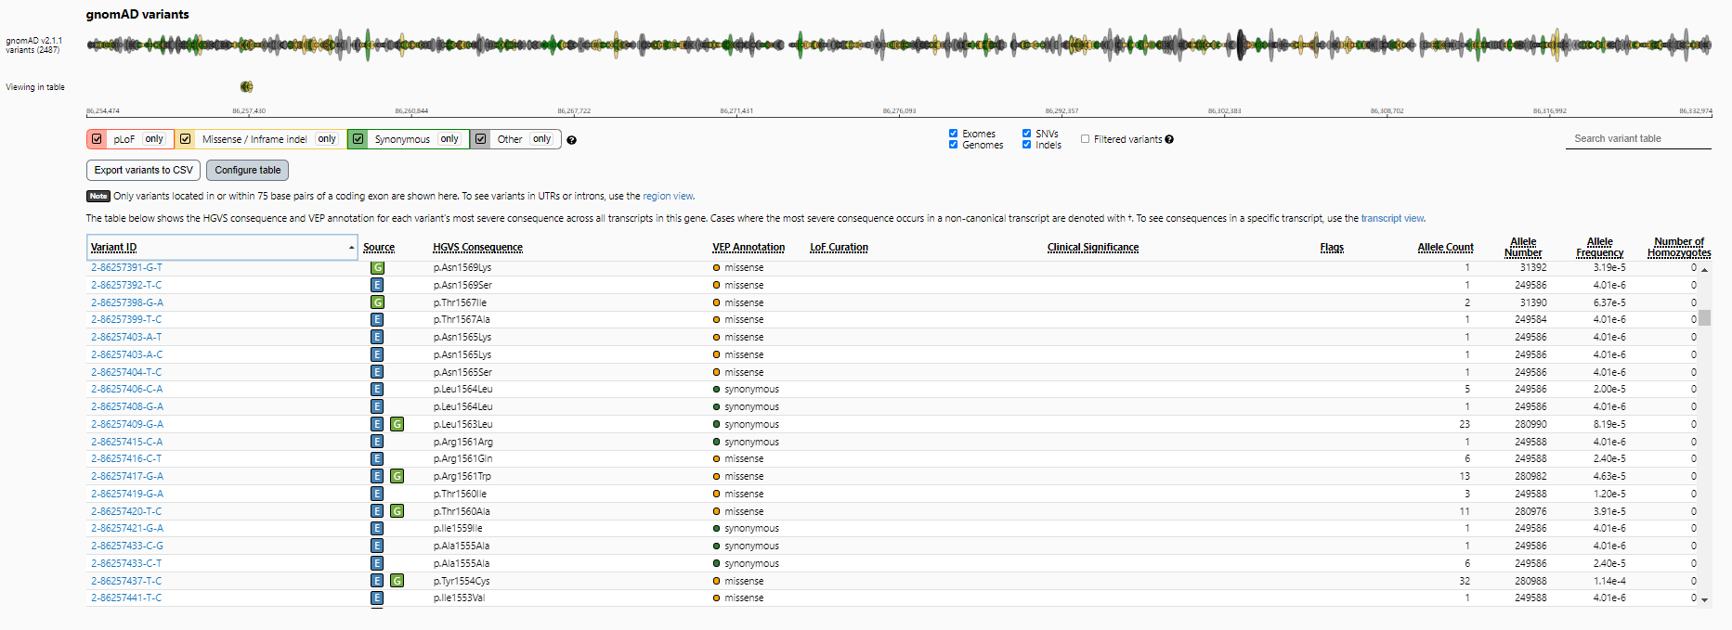
POLR1A c.4685 G>T, p.C1562F
-not present in Gnomad
Notes:
At the variant level, we can look at whether this specific variant (or one at the same position) has been reported in anyone in gnomAD in heterozygote or homozygous form
There is not individual level data so you cannot look for compound heterozygosity in this data

Slide 14
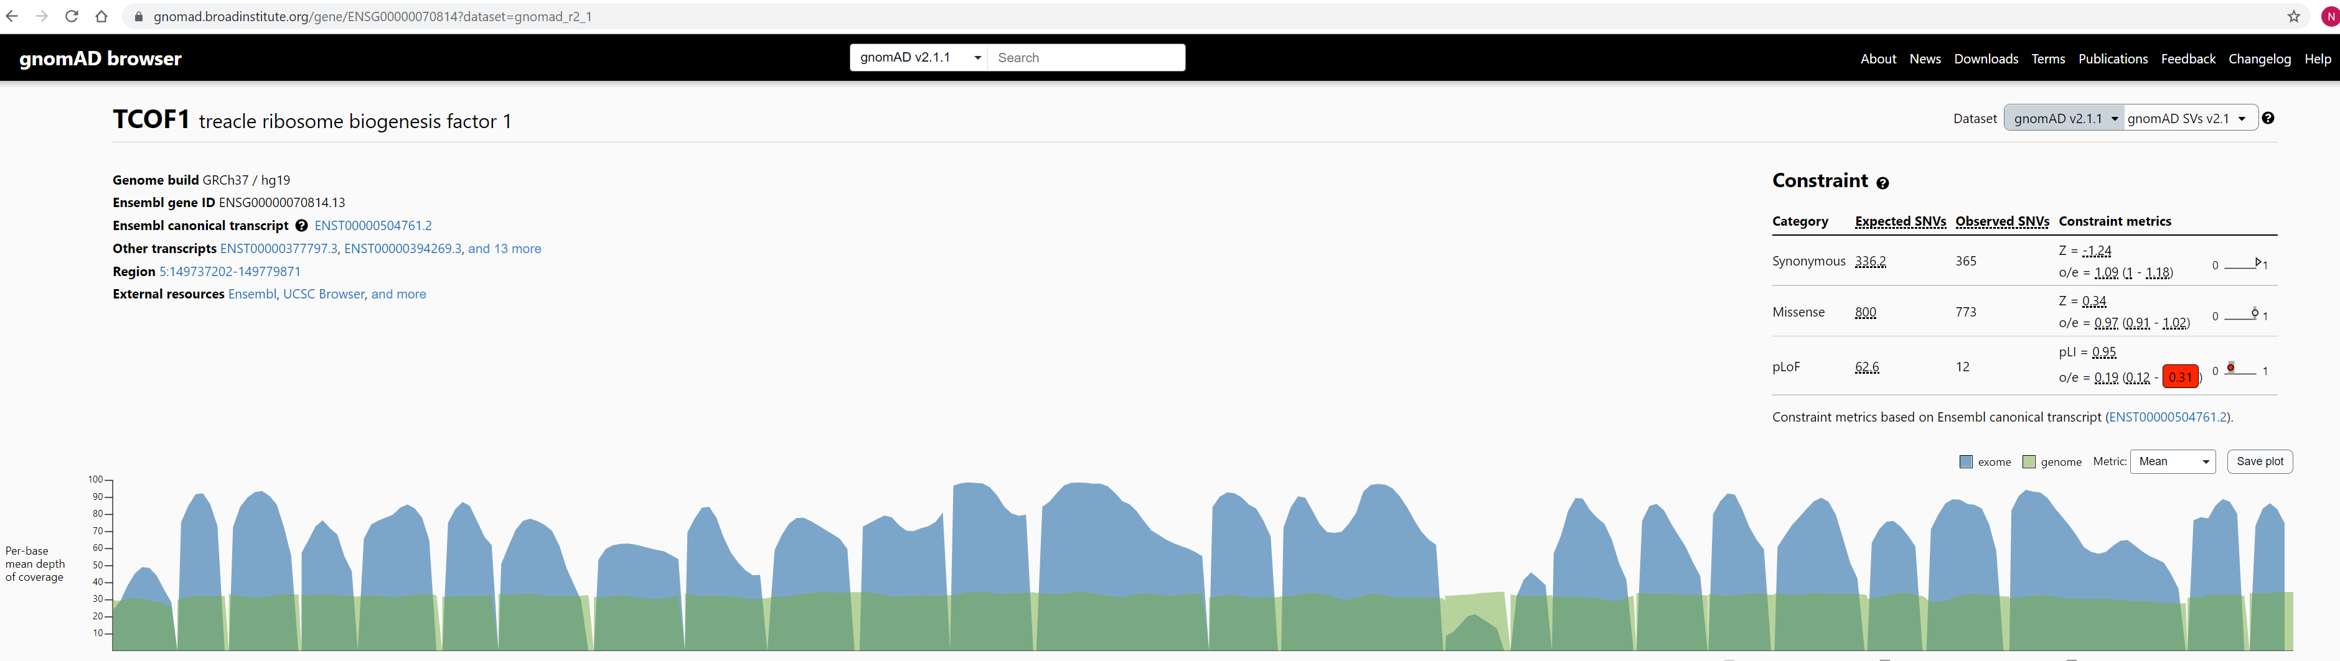
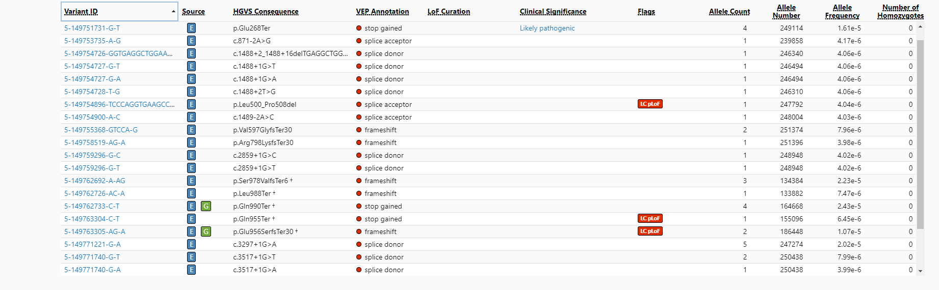
Limitations: Variable expression
Notes:
TCS variable—can see it in gnomad.
Other thoughts—accumulation of somatic path variants in some genes in which germline path variants cause a syndrome (ASXL1)

Slide 15
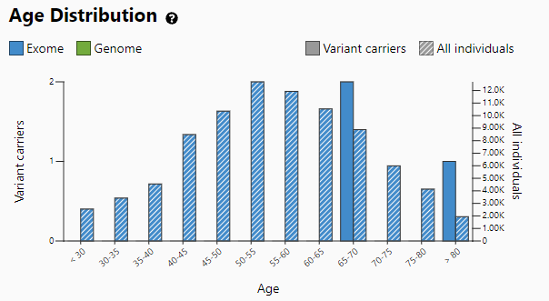
Limitations: Acquired somatic variants
ASXL1
Germline loss of function variants cause Bohring Opitz syndrome
Loss of function variants are found in GnomAD
Acquired, somatic variants
Notes:
BOS associated with craniofacial dysmorphism

Slide 16
Computational and predictive data
Notes:
There are many free online tools for variant prediction
These allow you to input a coding DNA change and get a prediction about pathogenicity which is based on a variety of different factors depending on the program you use
Examples of considerations include conservation and physiochemical difference between the amino acids which are switched
My current favorite is called Varsome because it gives you information from multiple different tools, plus gnomad, on one page.

Slide 17
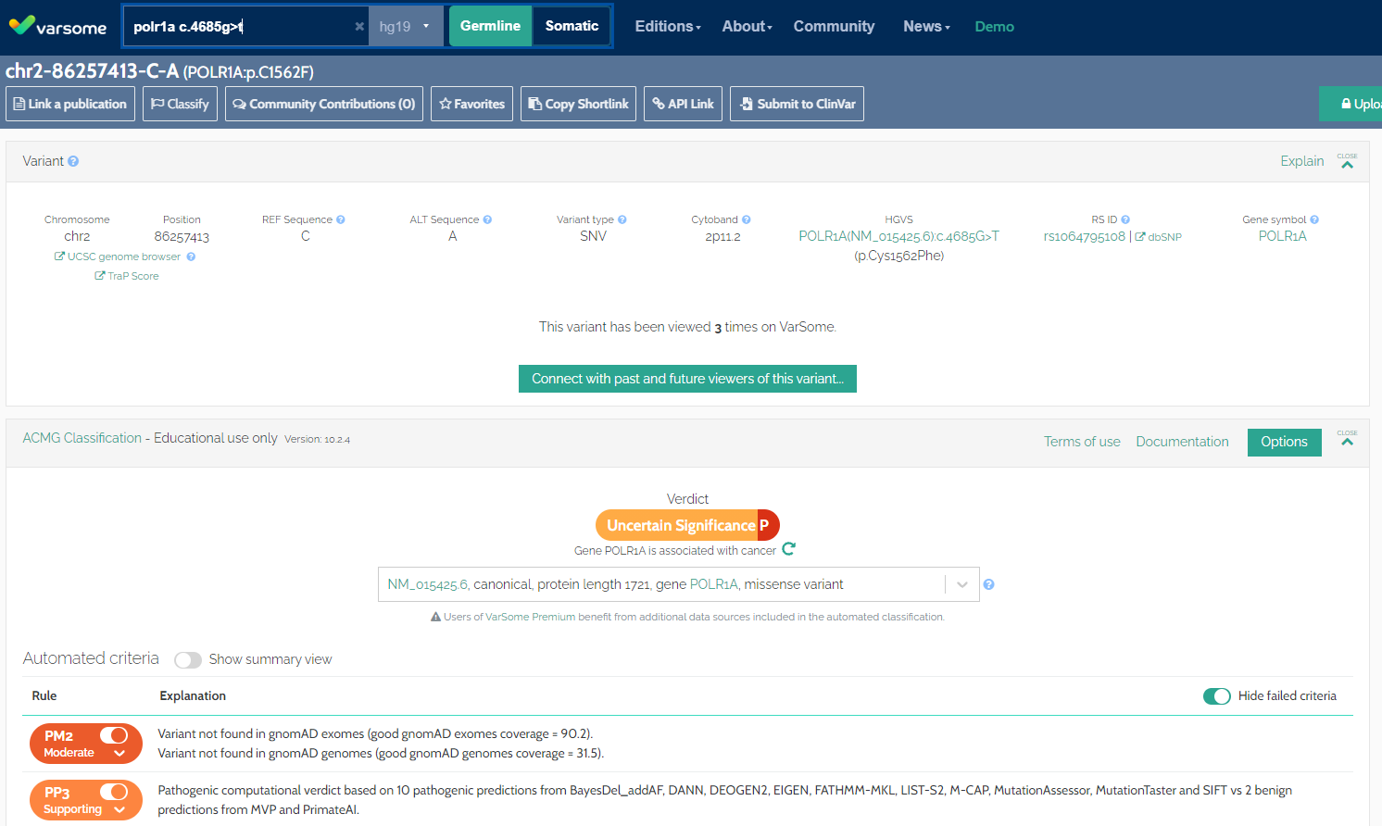
Notes:
Input is the coding change—c. (position) (ref base)>(alt base)
Not in gnomad—and there is good coverage at that region
Predicted pathogenic 10/12
ClinVar likely pathogenic
ClinVar—aggregate information about variants and human disease—information from labs, researcher

Slide 18
Segregation and De Novo data
Dominant:
Variant is found in affected individuals
Variant is not in unaffected individuals
Recessive:
Affected individual(s) with two variants
Unaffected individuals are carriers or reference
Take home:
Make sure you have phenotype and genotype data on all informative family members
Trio data is usually the most informative
Siblings helpful too, if you know their phenotype
Notes:
This is why trio and quad (etc) data is important
Phenotype is also very important here
But, variable expression can make the de novo assumption hard
How do we get this data? Evaluate the family members
Do you have the family members for trio
Important consideration when allocating scarce research dollars for research based sequencing/discovery
TCS family example

Slide 19
Allelic data
TCOF1
Dominant inheritance:
Variant of uncertain significance in trans with a known pathogenic variant
Recessive inheritance:
Variant of uncertain significance in trans with a pathogenic variant
Patient with phenotype consistent with the associated condition
Uncertain variant
pathogenic variant
Probably benign
DHODH
Uncertain variant
pathogenic variant
Probably pathogenic
Notes:
For variants in genes associated with dominant and recessive Mendelian inheritance, we have two alleles (one maternal, one paternal).
Variants “in trans” mean that they are on different alleles, as illustrated here, while “cis” means on same allele.
Knowing location of variants can help with interpretation of dominant and recessive variants

Slide 20
Functional data
Functional assay (e.g., enzyme assay)
Splicing effects (RNA sequencing)
Model organism (knock-out vs knock-in)
In vitro model
iPSC from patient?
Context is important: consider type of variant in the patient
Null vs missense
Loss of function vs gain of function
Notes:
Take home: Variant effect is important especially if mechanism for pathogenicity is gain of function, vs loss of function

Slide 21
Other information
Supports pathogenicity:
Recurrent de novo variant in patients with same phenotype
Phenotype is highly specific for the gene
Variant affects important position of the protein (e.g. active site)
For novel gene: protein product is part of a complex containing genes with associated disorders with similar phenotypes (e.g., POLR1B and TCS)
Supports benign:
Alternative cause of phenotype identified
E.g., variant of uncertain significance in POLR1A in a child with TCOF1 pathogenic variant and typical TCS→ probably benign
Notes:
Phenotype highly specific for the gene (I’ve seen this with Noonan syndrome genes)

Slide 22
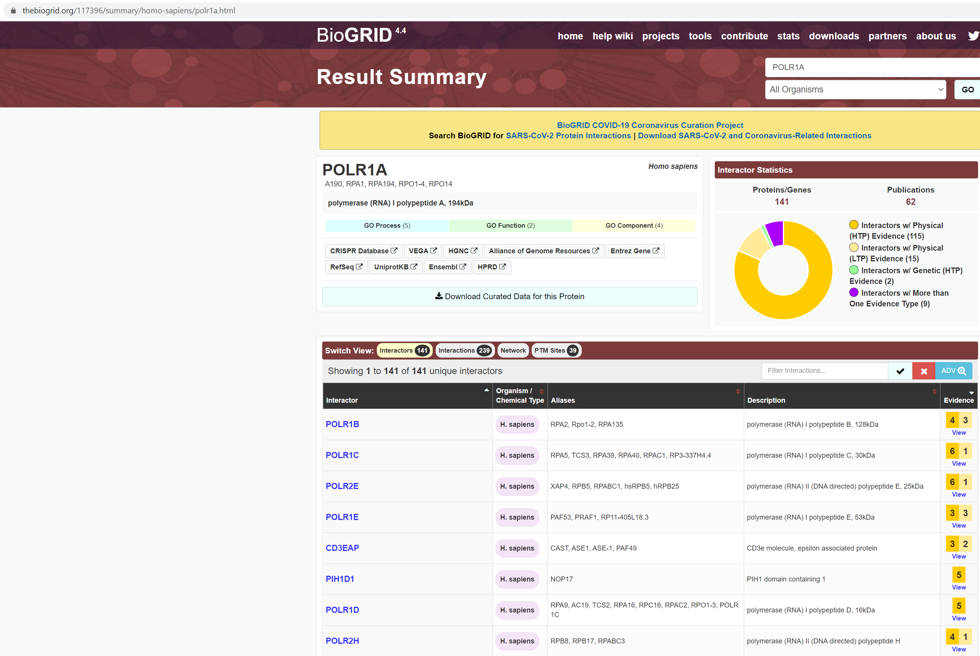
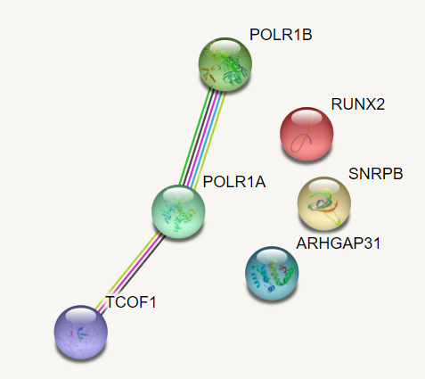
https://string-db.org/
Notes:
Protein-protein interactions can also be helpful
Here I’ve shown two online resources. One requires that you put in a list of proteins and it will show you if there are any interactors
The other shows you known interactors for a given protein

Slide 23
Variant classification: POLR1a p.C1562F
Data point | Consensus
Population data | POLR1A highly constrained; variant is not in gnomad
Computational and predictive data | 10/12 predicted pathogenic
Functional data | Mouse allele is lethal
Segregation data | n/a
De novo data | De novo
Allelic data | n/a
Other database | n/a
Other data | -Recurrent variant in two unrelated children with same phenotype -Other POLR1 subunits associated with neurologic disease
Notes:
These are summarized in a paper from the American College of Medical Genetics (list ref)
Now that we talked about the characteristics to consider when contemplating whether a variant may be pathogenic, let’s talk about how to FIND these variants

Slide 24
Finding a variant/gene of interest
2021 Exome trio
2021 Genome trio
1,433,069
6,838,829
Quality control
100,206
4,858,374
Population data
51,078
4,803,808
Effect (loss of function, missense)
737
868
Inheritance pattern (de novo)
28
9
Manual review
Notes:
Exome and genome sequencing generate a lot of variants
By using the same properties I just discussed, you can filter out many of them in order to focus your time on the highest yield variants
Here, we’ve eliminated variants present in more than .001% of the population, restricted to variants with predicted loss of function or missense effects, and restricted to variants found only in the proband and not in the parents
By doing this, we’re left with 28 variants from our exome and 9 from our genome
If you are looking at recessive variants, you might to relax your population data % because with recessive, heterozygotes are carriers (not affected) so expected that you might see some in general population. However, since we are looking for novel genes might assume that whatever you’re looking for probably is still pretty rare
Depth > 10
Novel phenotype-disease matching tool for rare genetic diseases. Chen, J; Xu, H; Jegga, A; Zhang, K; White, PS; Zhang, G. Genetics in Medicine. 2019; 21:339-346.

Slide 25
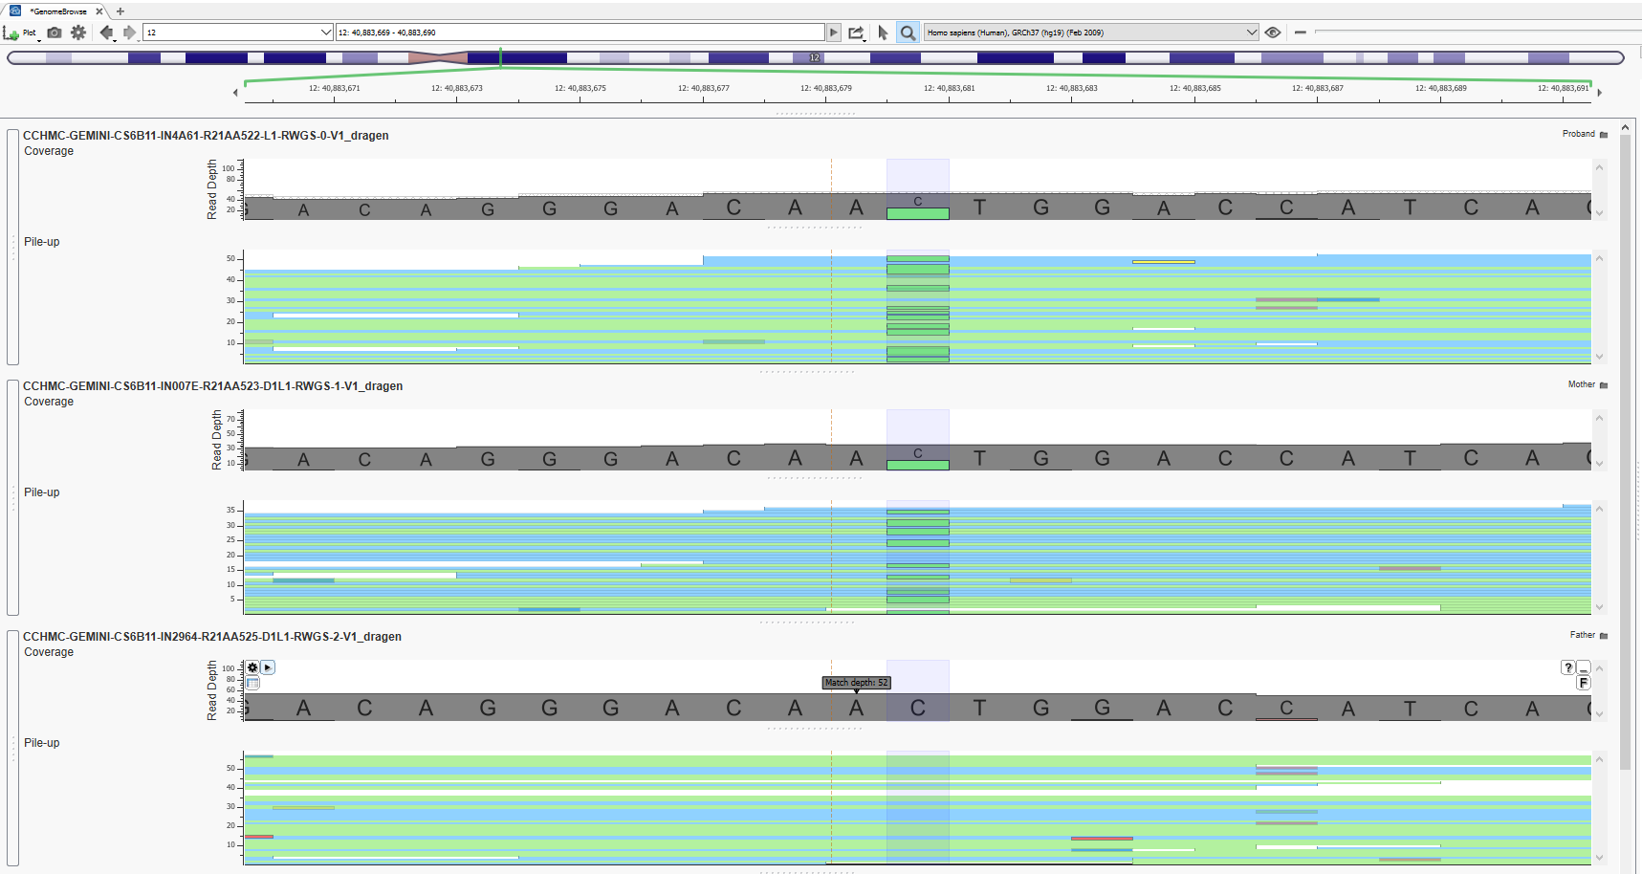
Individual Variant Review
9 de novo variants after filtering
Proband
Mother
Father
Notes:
Ideally at this stage you are able to find 1 or 2 variants of interest to focus on
With novel genes (not previously associated with human disease), more reliant on “functional data”—what has been shown about gene in animal or in vitro, can it apply to patient phenotype, or is the gene adjacent to a pathway/genes that is associated with similar phenotype
There are pathway-based filters as well, which use this type of information to help narrow down a gene list

Slide 26
What’s next?
Candidate gene identified
Variant is rare/novel, predicted pathogenic, segregates with disease
How to find more patients?
How to find someone interested in your gene?

Slide 27
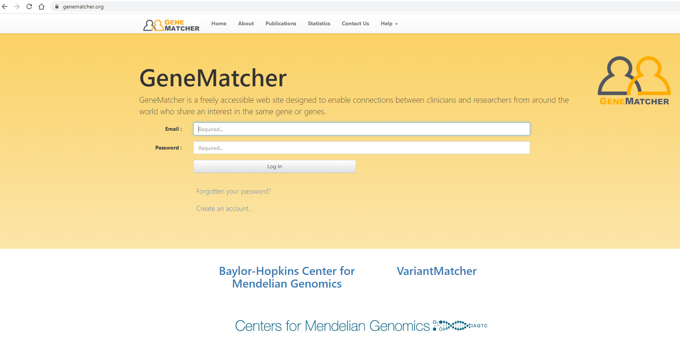
Finding more patients

Slide 28
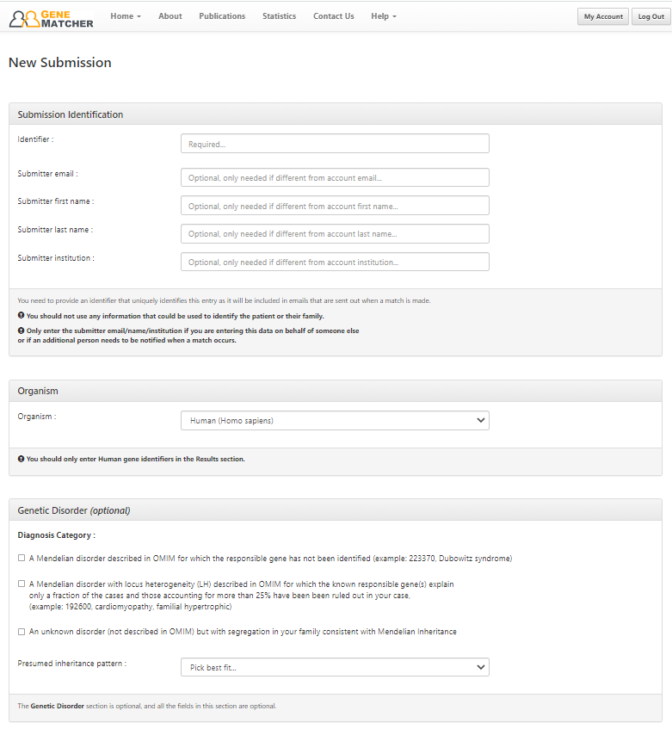
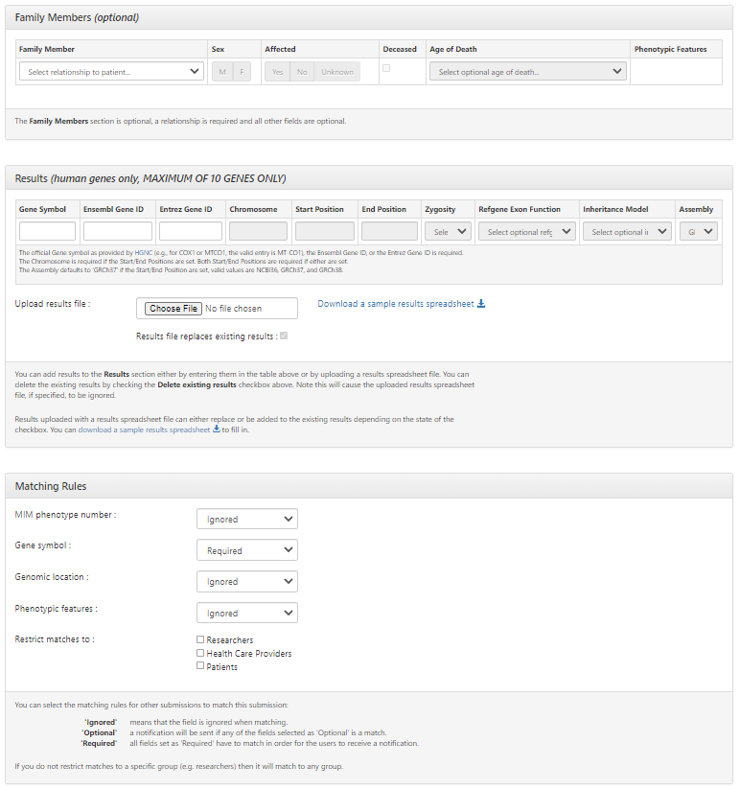
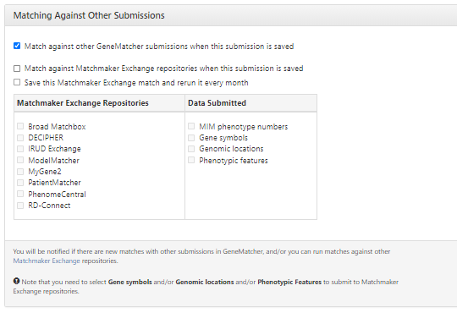
Notes:
Very easy to use
Options about which groups you want to be matched with
When there is a match, you get an email with gene name (“identifier” is important if you have multiple patients!) and names and emails of who you’ve matched with
I use this for novel genes, and also for really rare genes (e.g., recently described and only a handful of patients and phenotypes reported)
For the last part of this session I will discuss options for kids who have had recent exome or genome sequencing and still remain diagnosed.
Again will use one of my clinical and research patients as an example.

Slide 29
This MUST be genetic….
Newborn with craniofacial anomalies including partial acrania
Test results:
Clinical exome trio: 1 variant of uncertain significance
Microarray:
Notes:
Clinical exome also informed us that the 7p15 duplication is de novo

Slide 30
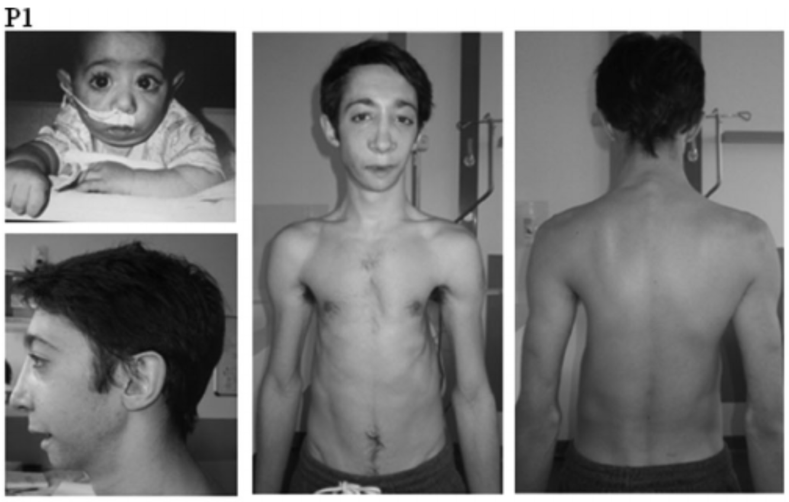
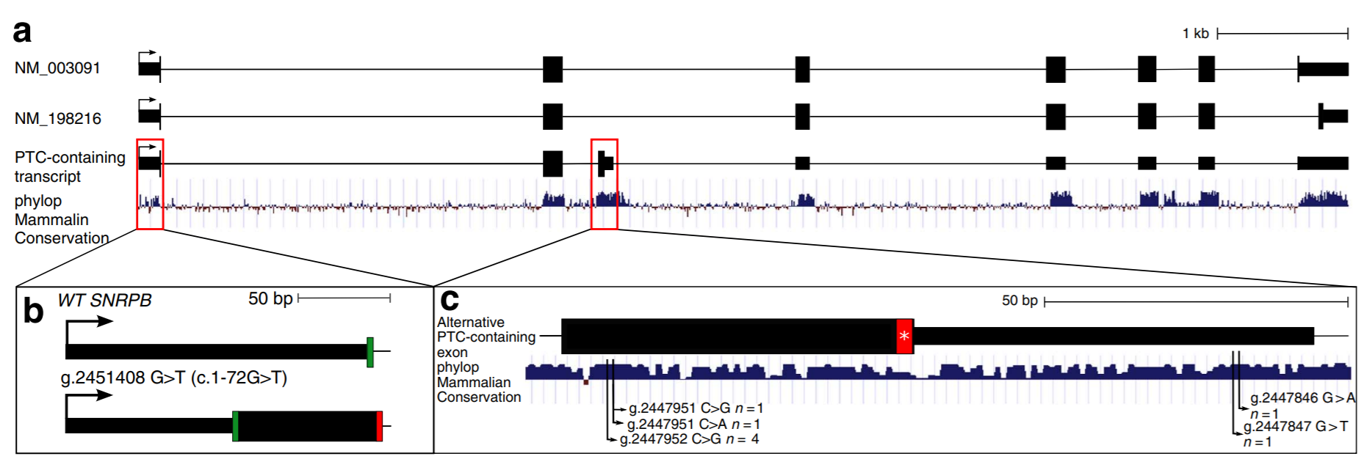
What next?
Variant of uncertain significance in SNRPB
c.530C>A;p.Pro177Gln (maternal)
Pathogenic variants in SNRPB associated with dominant cerebrocostomandibular syndrome
Clinical targeted RNA sequencing confirmed normal expression in leukocytes of our patient: “No significant changes in transcript levels or splicing patterns noted in SNRBP gene for this tissue”
Bactro et al 2014, Human Mutation
Lynch et al 2014, Nature Communications
Notes:
CCMS associated with with Robin sequence and rib gap defects
SNRBP has 3 transcripts. The variants reported in patients with CCMS cause inclusion of an alternate exon 3, which contains a premature termination codon
So—the variants cause splice defect leading to a truncated protein. This was shown in fibroblasts from patients—reduced total mRNA expression of SNRBP (all transcripts), increased expression of the alternate exon 3 transcript relative to others (Nature Communications) as well as in leukocytes
Our patient’s variant is in exon 5, predicted to be missense (amino acid change)
But, to be sure, we sent targeted RNA sequencing clinically.
To me, this was an important clinical step that needed to be done prior to moving toward research analysis/testing

Slide 31
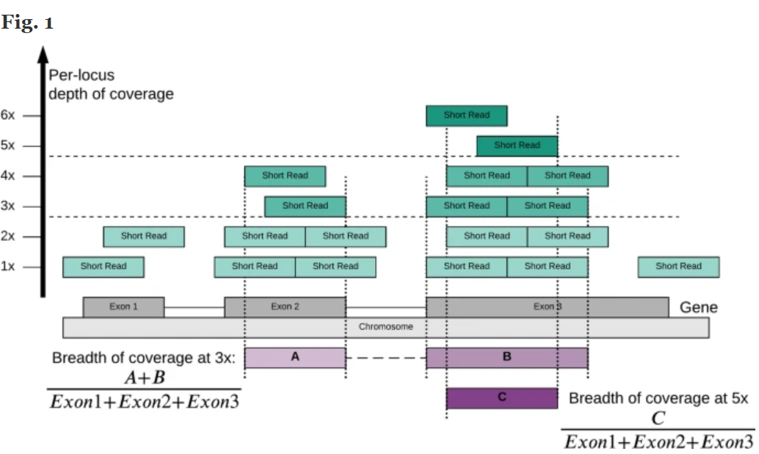
After exome/genome
Research re-analysis of exome
Exome → genome?
Older exomes with less even coverage than newer
Genome+RNA-seq
Long read genome sequencing
Coverage
Lee et al BMC Bioinformatics 2021
Notes:
Concept of coverage illustrated in this figure

Slide 32
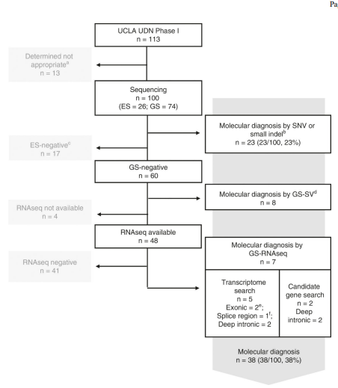
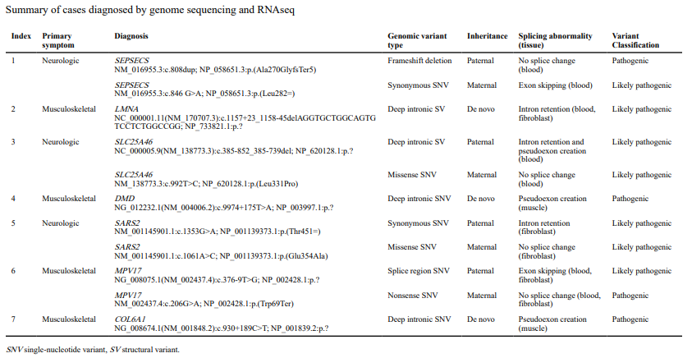
Genome sequencing with RNAseq
Lee et al Genet Med. 2020 March ; 22(3): 490–499.
Notes:
UCLA is a site for undiagnosed disease network and enrolled these patients
Improved yield with GS augmented by RNAseq
Small series, but illustrates the improved yield with addition of RNAseq on different tissues
Allows assessment of splice impact of synonymous variants, splice site variant, and deep intronic variants

Slide 33
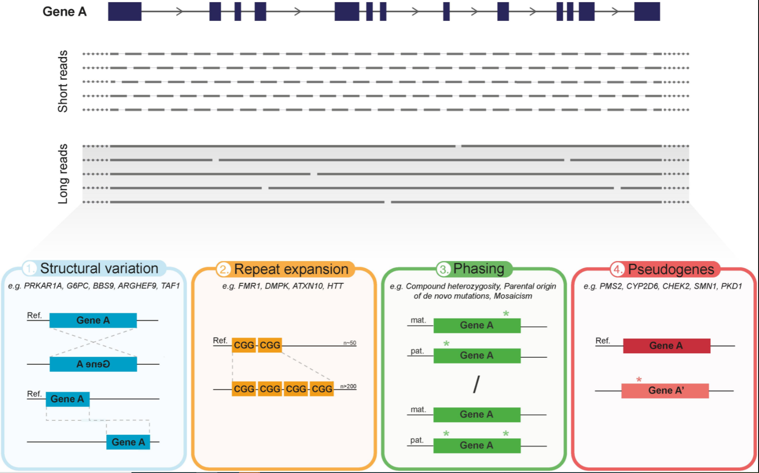
Long-read genome sequencing
Mantere et al Front. Genet., 07 May 2019
Notes:
Long read vs short read sequencing
150-300 bp reads vs 10kb
This allows detection of structural variation (inversion, translocation), repeat expansion (triplet repeat), phasing (are variants in cis or trans, did de novo variant occur on maternal or paternal allele), and distinguish pseudogenes from clinically relevant gene
Problem—it is expensive and a lot of data
Targeted long read—focus on a gene of interest if you have high suspicion the clinical phenotype fits with gene
Example: recessive disorder phenotype but only a single path variant detected with clinical testing. Targeted long read of that gene might find the second hit
Front. Genet., 07 May 2019 Mantere et al

Slide 34
Summary
There are an abundance of tools and characteristics to consider when you are presented with a candidate variant in a novel gene
Important to ask if appropriate clinical testing has been done
Exome/genome is not always going to find an answer
Functional validation is a bottleneck for gene discovery
Communication between clinicians and researchers is essential
Notes:
Open lines of communication between clinicians and researchers is essential for moving more patients from undiagnosed, to diagnosed!
Ensure appropriate clinical test done first—this provides answer (or non-answer) to patient with defined turn around time—and allows allocation of scarce research resources toward highest yield cases

Slide 35
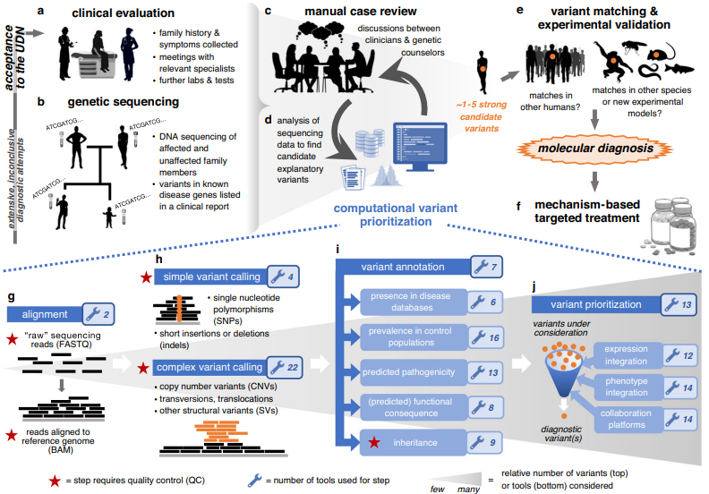
Resources
https://gnomad.broadinstitute.org/
https://varsome.com/
https://omim.org/
https://www.ncbi.nlm.nih.gov/clinvar/
http://www.hgmd.cf.ac.uk/ac/index.php
https://genematcher.org/
https://string-db.org/
Thebiogrid.org
franklin.genoox.com
Kobren et al Genetics in Medicine (2021) 23:1075–1085
Notes:
I’ve focused mostly on free resources
VarSeq is not free but it’s the one I am most familiar with because I’ve used it for a long time. It is possible to filter in excel if you have the right type of file
I like being able to filter variants myself but also work with someone in bioinformatics who uses a custom pipeline which incorporates phenotype terms. So it’s nice to see what each of us comes up with using different pipelines
Franklin by genoox is free and is a newer one I just learned about

